Slide 1
South Hero Village Visioning Workshop
2023 South Hero Town Plan Update
September 7, 2022

Slide 2
Outline
Goals/Intent of Workshop
Town Plan Update Overview
Demographics
Village Planning – History and Intent
Visualizing Density
Village Vision Discussion/Flipcharts
Workshop activity

Slide 3

Goals/Intent of Workshop:
Refine vision for South Hero Villages

Slide 4
Town Plan Update Overview
Summer 2022
Fall/Winter
20222
Winter/Spring 2023
Spring/Summer 2023
Community Events Held
Plan Chapters Drafted
PC Reviews Draft Plan
Updated Town Plan Adopted
Survey (June)
Community Cheers & Cheese (June & August)
Village Vision Workshop (September)

Slide 5
A few key demographics…

Slide 6
Current Housing Characteristics
1,070 housing units
35% of all units are used seasonally.
2% of all units are used as full-time short-term rentals (May-October)
85% of all year-round units are owner-occupied. 15% of year-round units are renter-occupied.
89% are single household detached dwelling.
19% of housing units are built prior to 1939.

Slide 7
Forecasting Future Needs
Create a baseline of potential growth to consider future needs
Assumes average or high growth for purposes of planning
Actual growth is difficult to forecast (e.g. 2010 predictions for South Hero)

Slide 8
Estimated Future Housing Needs
Year | New Housing Units (vs. 2020)
2030 | 40
2040 | 80

Slide 9
Planning South Hero’s Villages – Recent History
Village Working Group (2000)
  "Develop a vibrant village, where all can live and travel safely.“
  South Hero Traffic Calming Plan (2001)
Findings of Northwest VT Project (2006)
  Buildout Analysis under current zoning shows future development spread out throughout town, not concentrated in the village areas.
  Soils, based on capacity for on‐site septic systems, are controlling development in town, while zoning has little effect.
  Sprawl along transportation corridors is likely to occur at full buildout under current regulations.
  Affordable housing may not be a part of future development based on land value, second home development, and no village area to encourage density.
South Hero Town Plan (2009 and 2015)
  The Town should define village areas in the zoning regulations, encourage development there and take steps to improve their appearance, establish sign and height standards, and set and enforce appropriate speed limits. (2009 and 2015)
  Proposed Land Use Map showing village districts (2009 and 2015)
  Develop form based zoning for villages (2015)

Slide 10
Planning South Hero’s Villages – Recent History
  High Priority Recommendations of Village Planning Forums (2009)
    Wastewater Planning (✓)
    Streetscape Improvements for traffic calming and placemaking (✓)
    Village Designation (✓)
    Zoning Amendments, including reduced minimum lot sizes, reduced frontage requirements, a maximum front setback and other village standards. (✓)
State of Vermont Village Center Designation Program (2014, renewed 2022)
  Establishes boundary for historic core of village centers to bring financial resources and technical assistance for revitalization. Boundary does not include space for future growth.
  “the core of a traditional settlement, typically comprised of a cohesive mix of residential, civic, religious, commercial, and mixed use buildings, arranged along a main street and intersecting streets that are within walking distance for residents who live within and surrounding the core.” (24 V.S.A. §2793a).
Village Zoning Districts (2020)
  Established a village zoning district for South Hero Village and Keeler Bay
  Developed vision for zoning districts based on Town Plan, character analysis and community forums
  Developed form based standards based on vision

Slide 11
Village Districts – 2020 Zoning Vision/Purpose
Traditional village centers consisting of a concentration of residential, commercial and public land uses at higher densities than other parts of town.
  Commercial and mixed use development is encouraged.
  Walkable, pedestrian friendly streets, sidewalks and walkways.
  Human-scaled buildings with architectural details, landscaping and lighting.
  Integrated street network.
  Shops and services intermixed with homes.
  A variety of commercial establishments from retail shops to home businesses, professional offices, and tourist services.
  Places for the community to gather for social and cultural events.
  Small, low impact industry.
  Government services.
  Maintain historic character through design, siting and scale

Slide 12
Village District Zoning
 | Acres | Percentage
1. South Hero Village | 354 | 3.70%
2. Keeler Bay Village | 280 | 2.93%
3. Rural/Residential | 7383 | 77.14%
4. Shoreland | 1554 | 16.24%
Total | 9571

Slide 13
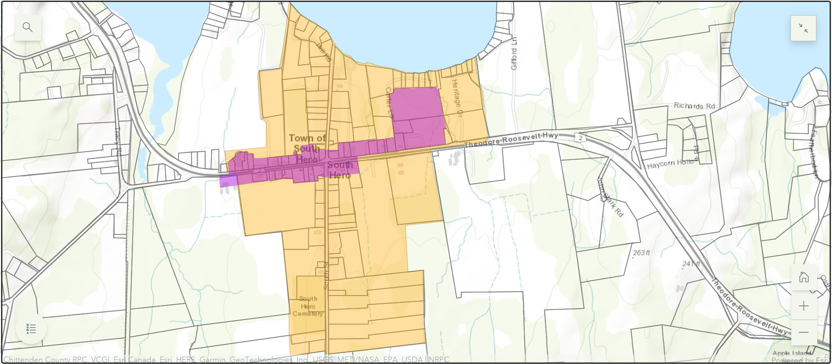
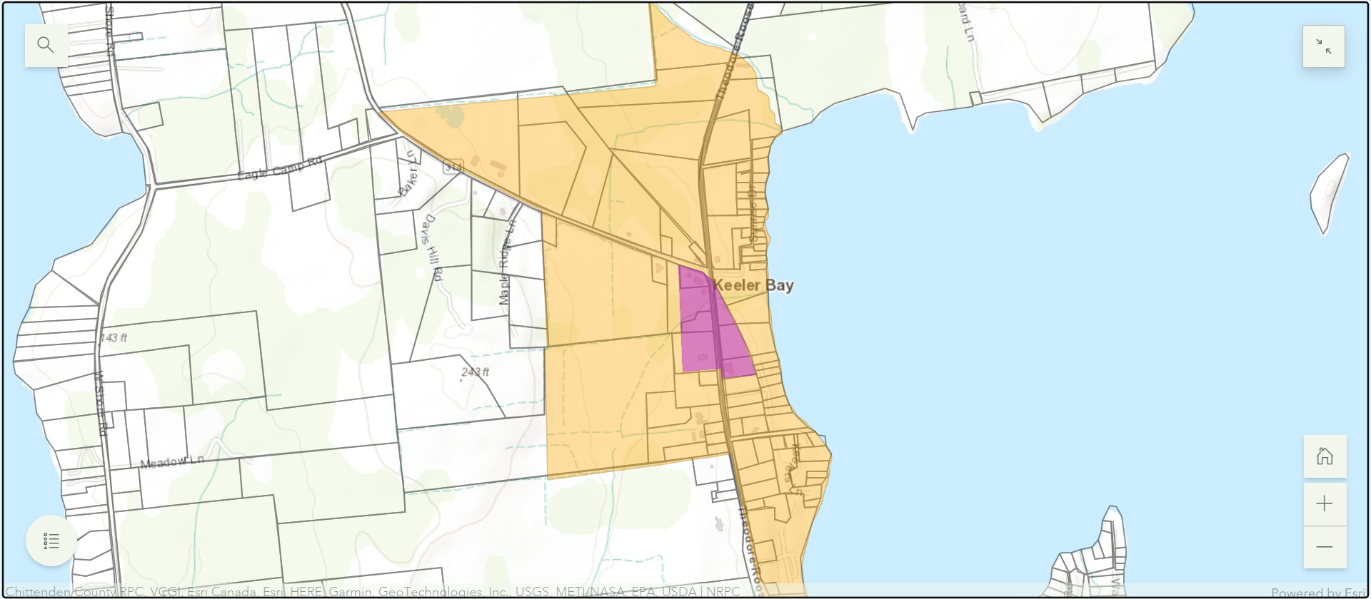
Designated Village Center (Not Related to Zoning)

Slide 14
Visualizing Density and Future Growth:
Spreading Out or Growing In
As South Hero plans for population and housing growth, “we can choose between two basic approaches to land development—spreading out or growing in and up.” Visualizing Density

Slide 15
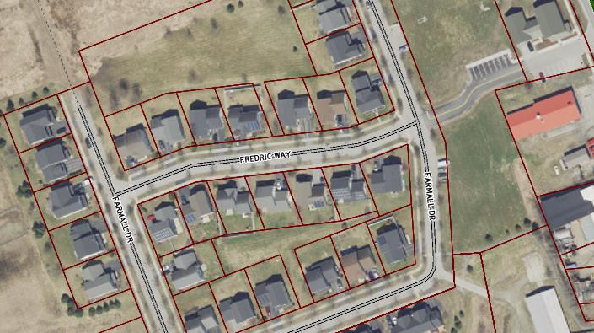
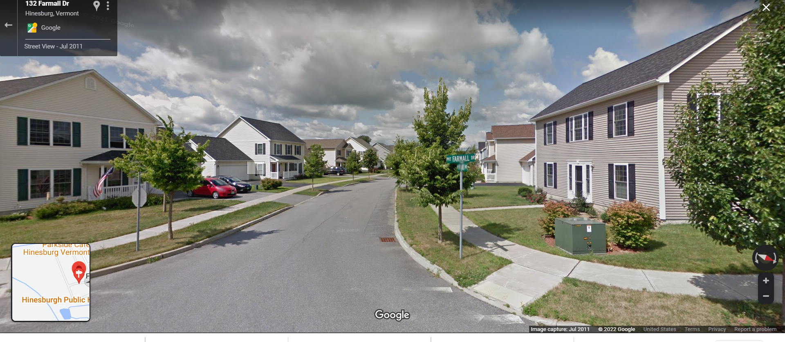
Visualizing Density Quiz
.15 Acre Lots = 6 units per acre

Slide 16
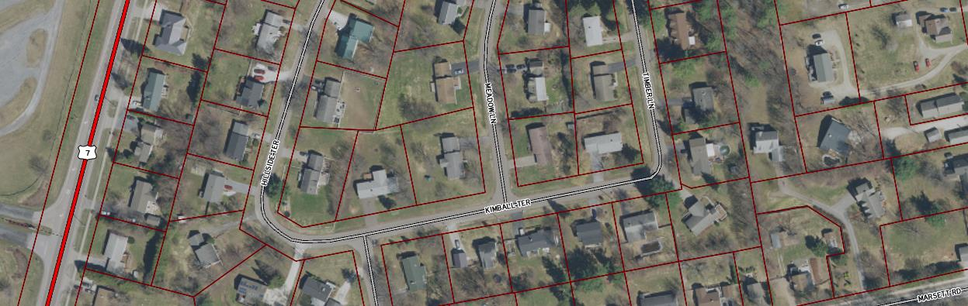
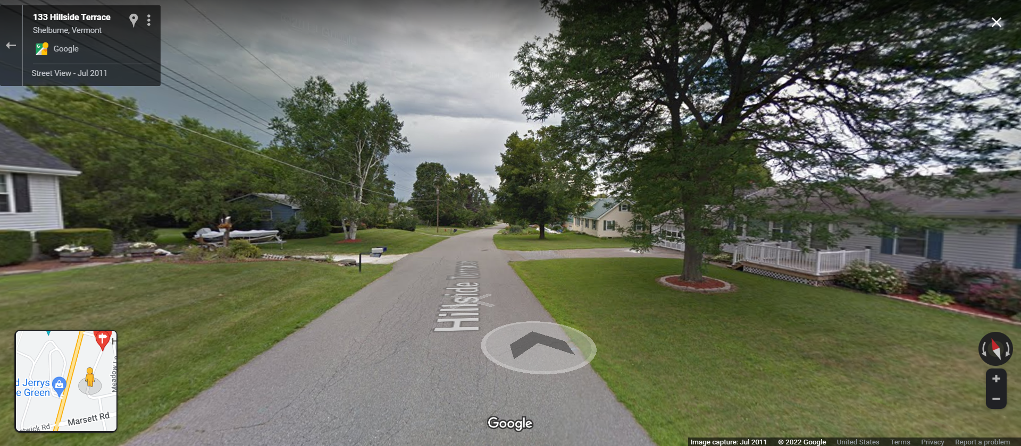
Visualizing Density Quiz
1/4 Acre Lots = 4 units per acre

Slide 17
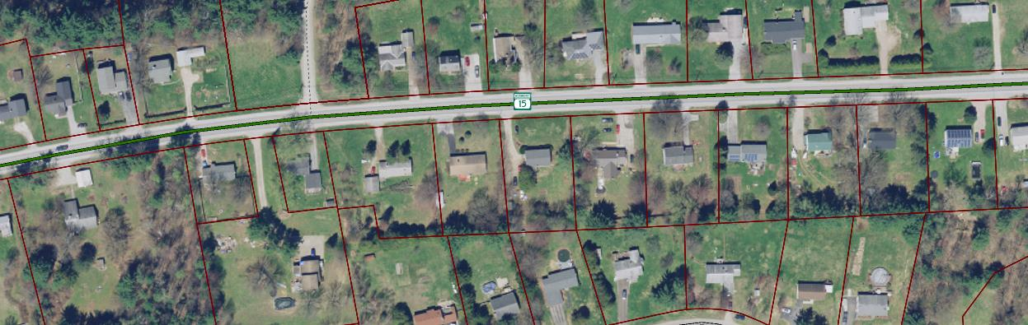
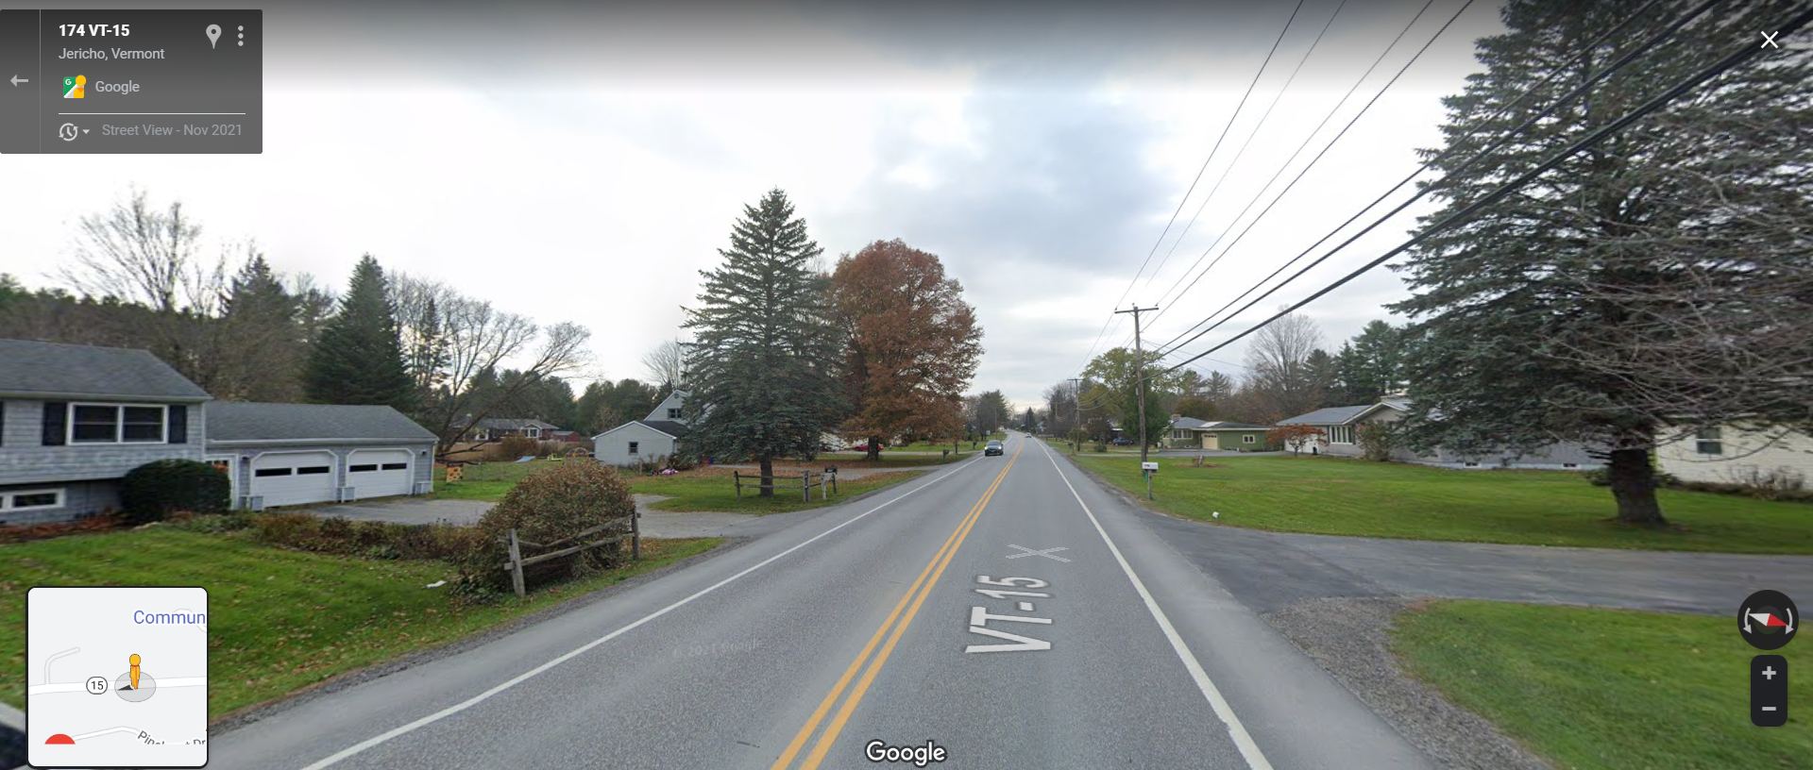
Visualizing Density Quiz
1/2 Acre Lots = 2 units per acre

Slide 18
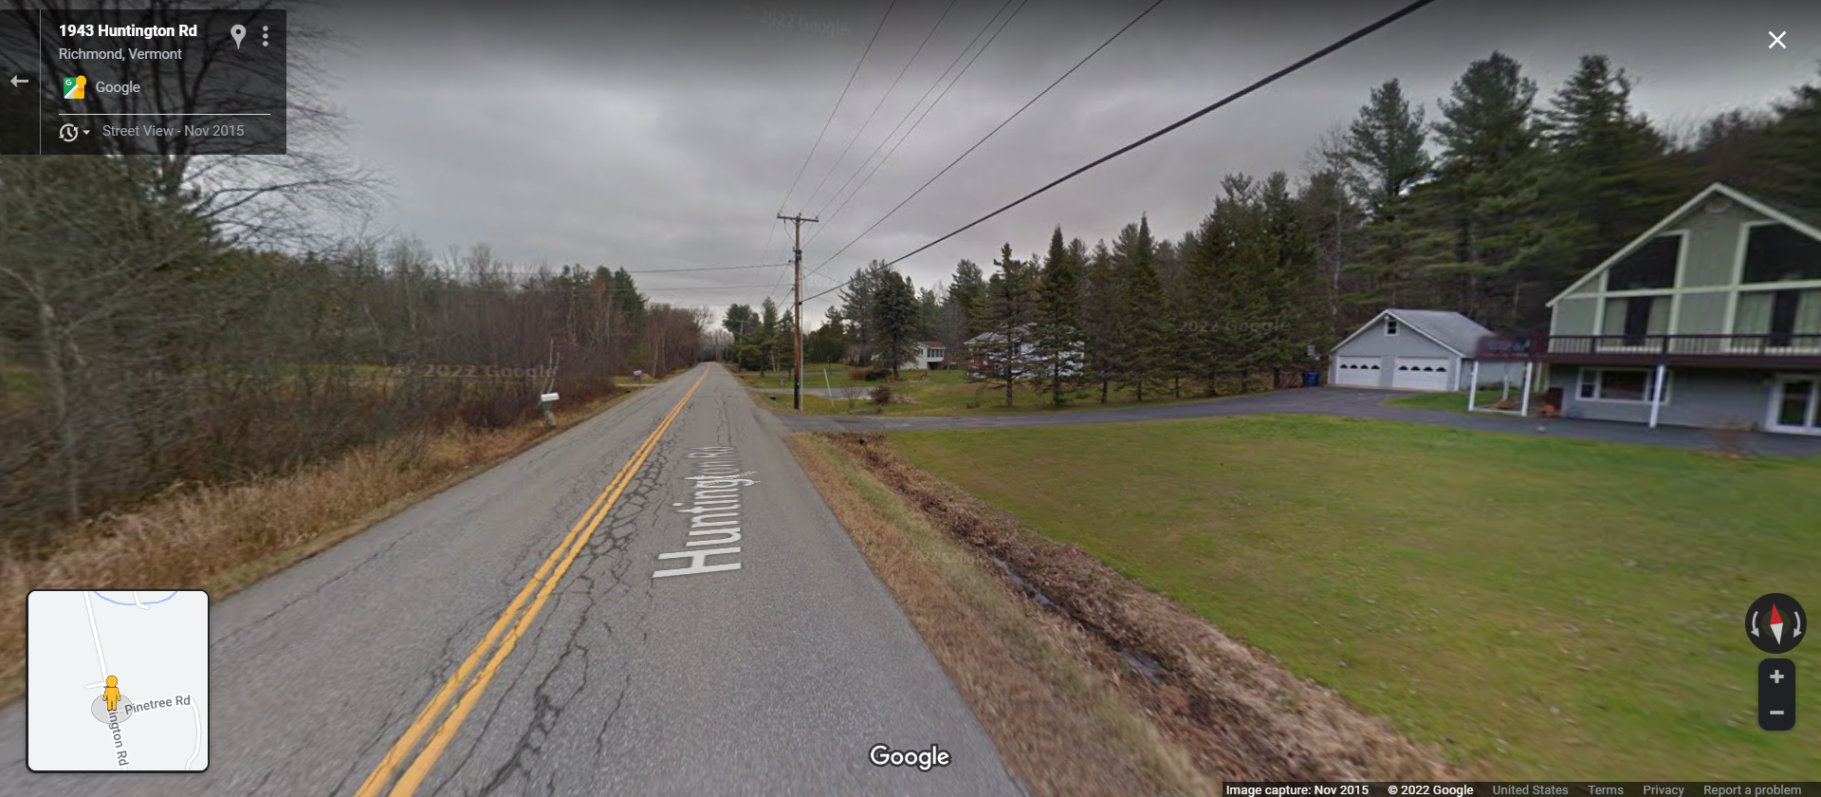
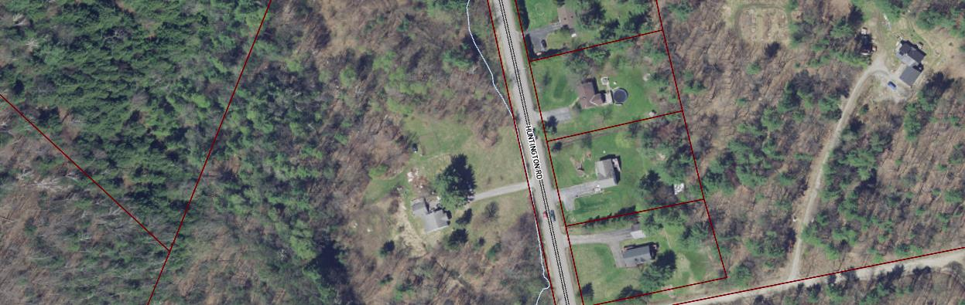
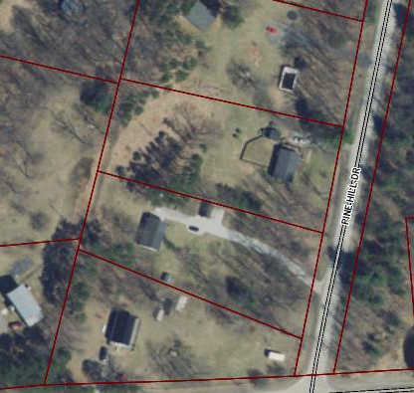
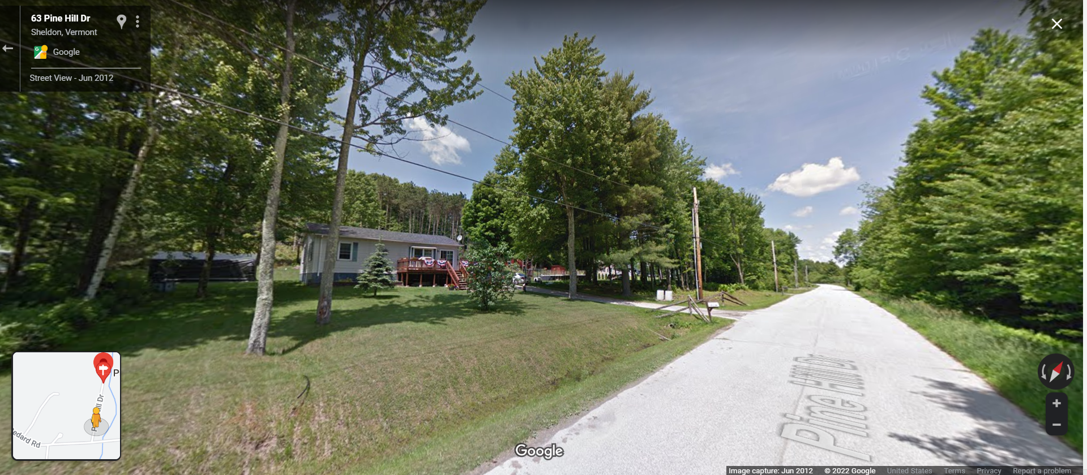
Visualizing Density Quiz
1 Acre Lots = 1 unit per acre

Slide 19
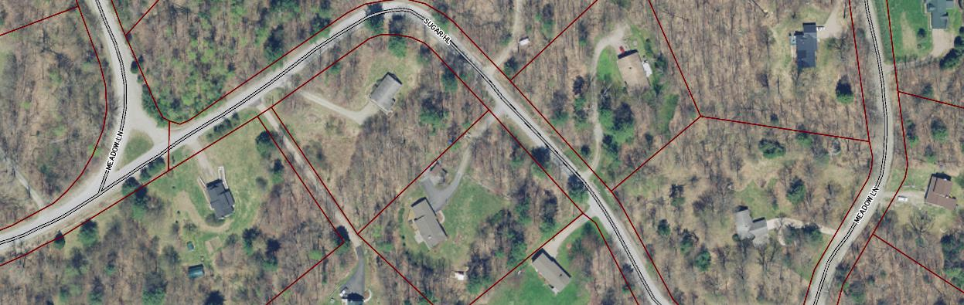
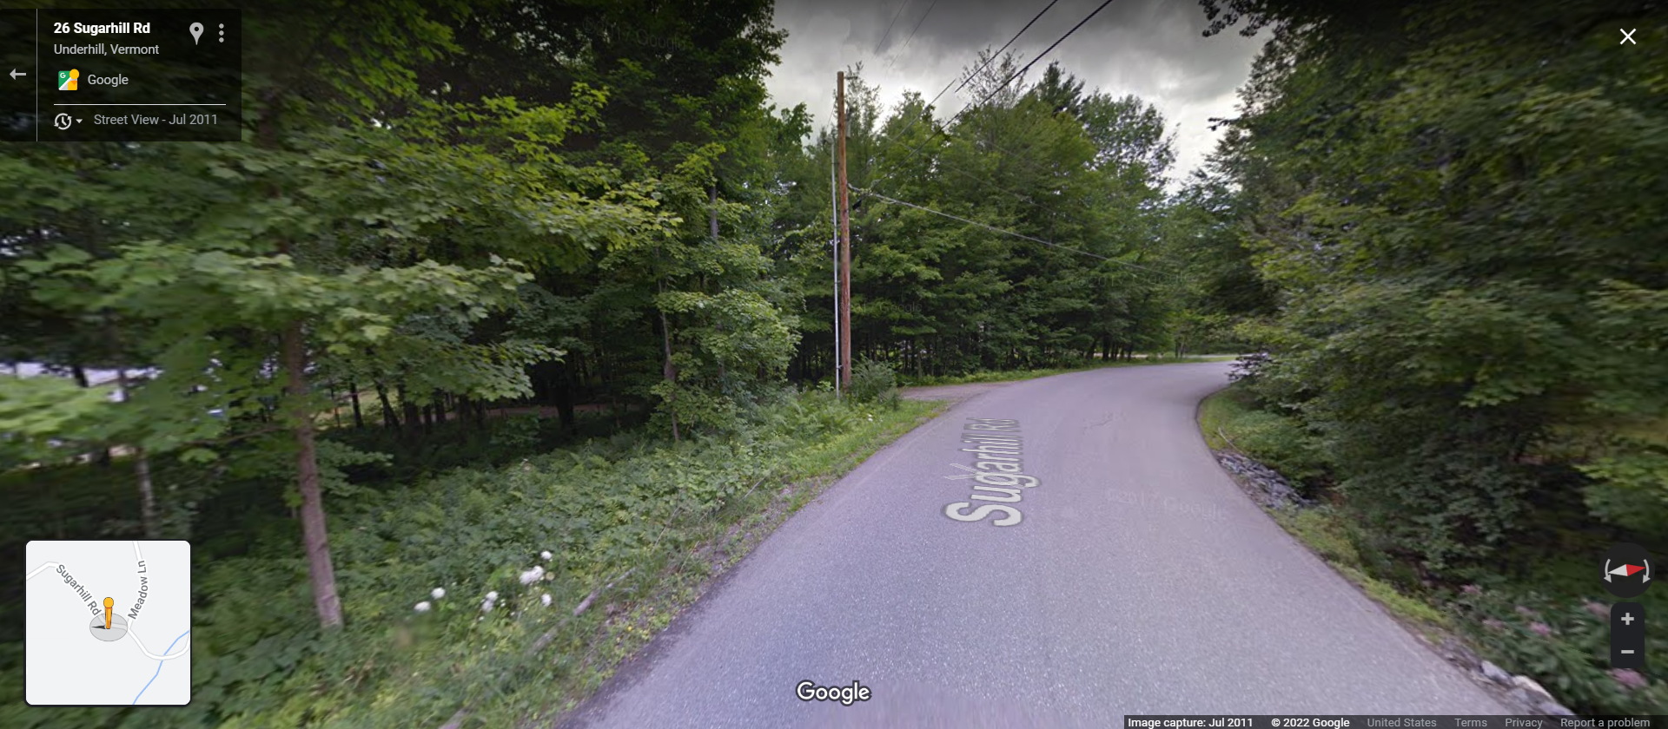
Visualizing Density Quiz
2 Acre Lots = .5 units per acre

Slide 20
2023 Town Plan =
Opportunity to further develop vision for village districts
East Montpelier Village Planning Areas
Bristol Village Planning Areas

Slide 21
2020 Planning Survey

Slide 22
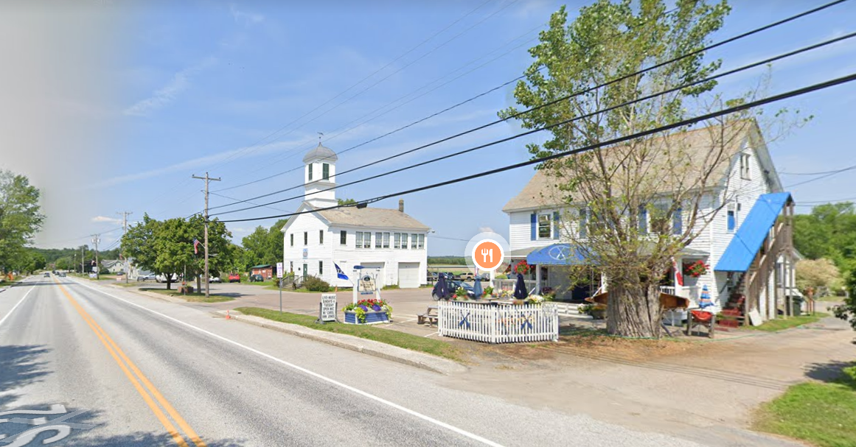
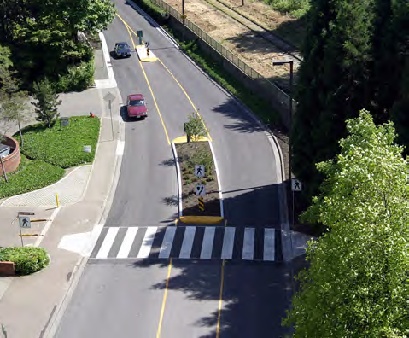
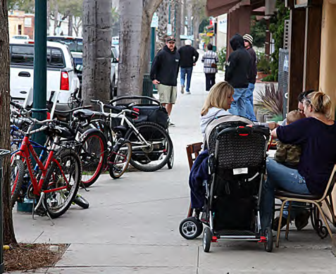
2020 Planning Survey
#2: Maintain Historic Character
#3: Walkable with connected, and well-maintained, safe sidewalks
#1: Safe Pedestrian Crossings
Credit: EPA Walkability Workbook

Slide 23
Flip Chart Discussion
  Describe South Hero Village today? Keeler Bay Village Today?
  Describe what you want South Hero Village to be in the future? Keeler Bay Village in the future?

Slide 24
Workshop Activity
  South Hero is growing – how should that growth happen in the village areas?
  Work together in 3 groups to allocate new development in the village areas.
  Each group has a poster map of the village area, with the entire village district, parcel lines and sizes noted.
  Each group has small wooden pieces to serve as housing units.
    Small size – Single unit house
    Large size – 2-4 unit house
    Stack to make stories, combine to make more units
    Mark with an X to be a business
  Allocate: 40 to 80 housing units and 5 - 10 businesses
  Draw in roads as desired (use pencil first).

Slide 25
Wrap Up
Discussion:
What did each group come up with?
Next Steps:
Planning Commission will use the input from tonight to develop a vision for the Town Plan specific to the Village Zoning Districts.
Questions:
South Hero Panning Commission
NRPC: Greta Brunswick (gbrunswick@nrpcvt.com) and Emily Klofft (eklofft@nrpcvt.com)

