Slide 1
Becoming A Friend in South Hero
Notes:
"A true friendship is defined by knowing someone has your back, no matter what. A good friend will watch out for you and ensure you are safe, feel supported, and are loved. A good friend will never purposely lead you into making decisions or taking actions that aren't good for you. A true friend will always have your best interests at heart." ~Lia Miller
The definition above from writer Lia Miller reveals that friendship is about feeling safe, supported, and loved. When I apply this definition to our work throughout the watershed here in northern Vermont, I see a number of parallels to our work as the Friends of Northern Lake Champlain.

Slide 2
Friends of Northern Lake Champlain
Who we are & where we focus our work
Tonight’s Discussion
Our Work
Why our work is important & how we’re getting it done
Your Part
How you can join our work in your community & beyond

Slide 3
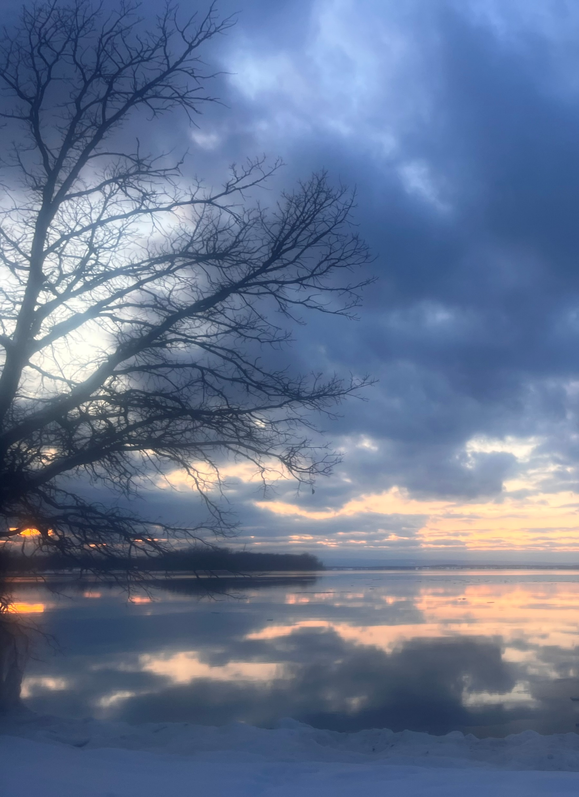
Our Mission
Friends of Northern Lake Champlain is a non-profit organization that acts to clean the waters of northern Lake Champlain and its watershed by working collaboratively with citizens, businesses, farmers and government in order to reduce land-use pollution.
Our focus is on catalyzing the actions and accountability needed to reduce land-use pollution and securing the essential local, state, and federal funding necessary for successful implementation.
Photo Kilkare State Park by Denise Smith
Notes:
The organization was formed close to 20 years ago by several Highgate Springs and Swanton residents who were focused on removing the causeways thought to be obstructing the natural flow between Missisquoi Bay and the Inland Sea of Lake Champlain.
Their work was critical in informing the Clean Water Act of 2015 also known as the Clean Water Initiative/Act 64

Slide 4
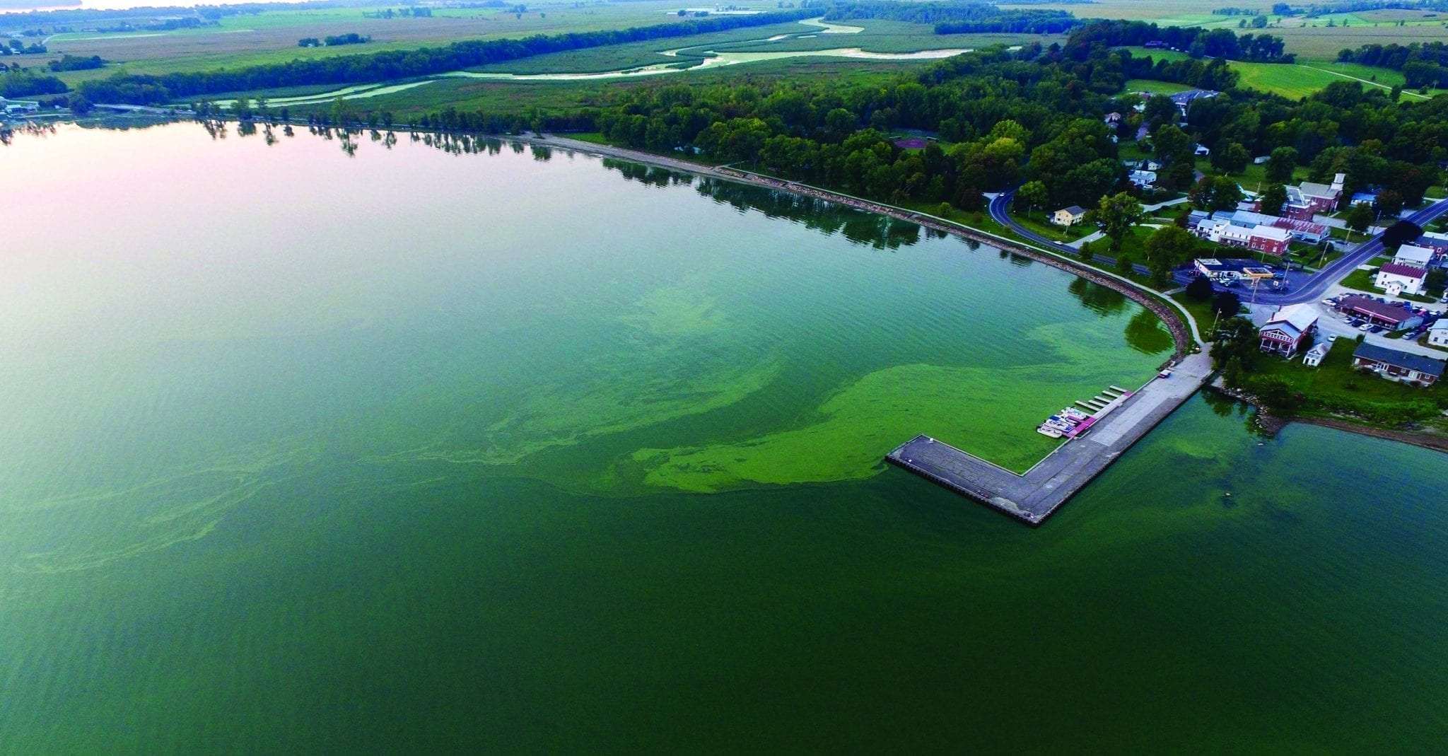
You Know the Why…
Photo by Armand Messier/northernvermontaerial.com
Notes:
Blue-green algae is one of the major concerns for water quality in the Northeast Arm and Missisquoi Bay. It is for this reason that FNLC has prioritized projects that manage and reduce phosphorus runoff before it reaches the Lake. We work with municipalities, landowners, and community members to assess areas of concern and implement projects that reduce nutrient loading.

Slide 5
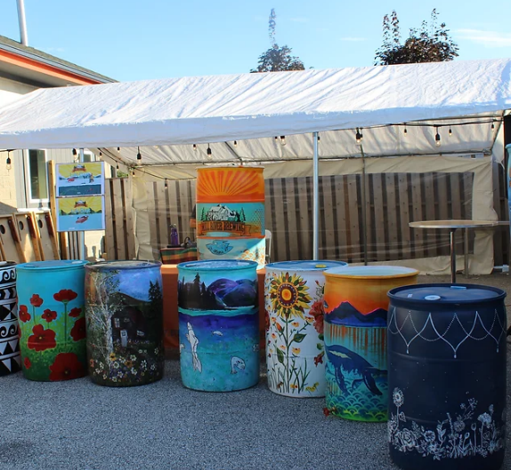
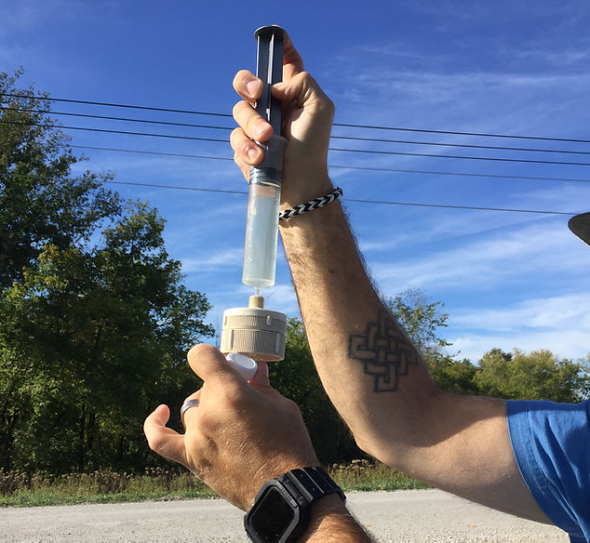
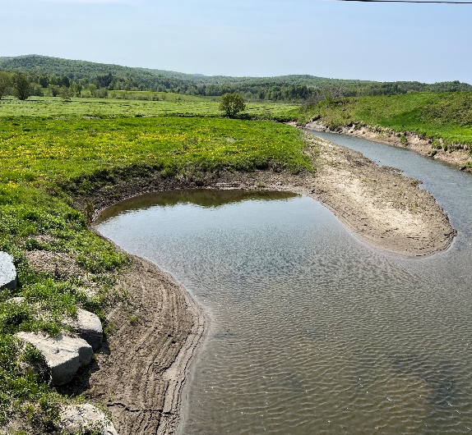
Community Outreach
How We’re Taking on Phosphorus
Engaging the public in connecting & understanding
Monitoring Water Quality
Bringing consistent data to our work to inform our projects
Water Quality Projects
Finding & supporting non-regulatory solutions

Slide 6
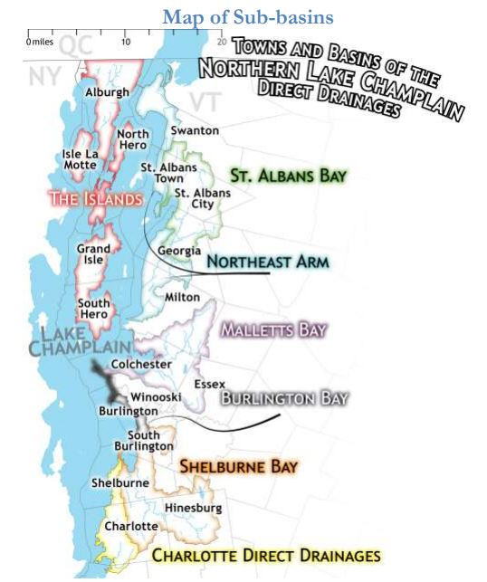
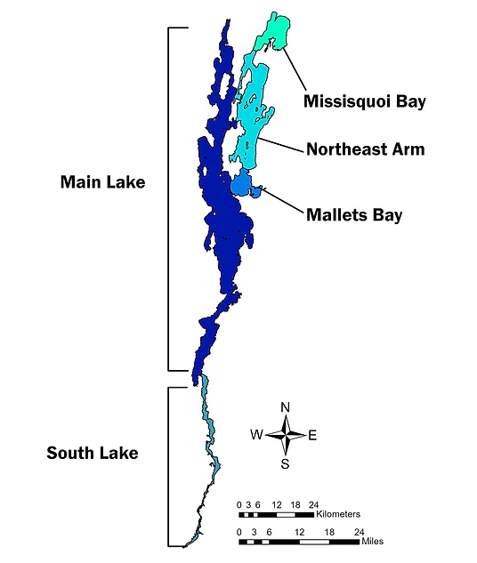
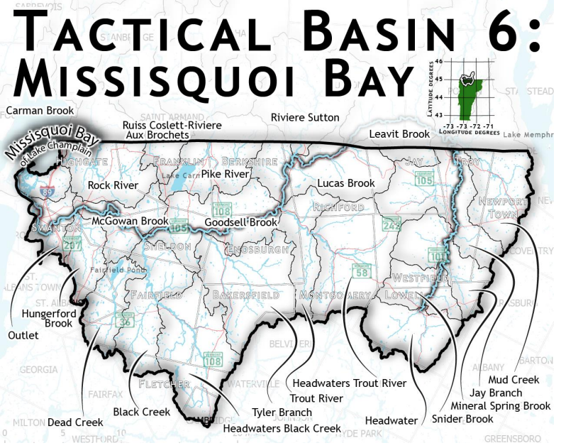
Our Service Area
Franklin & Grand Isle Counties
Northeast Arm & Missisquoi Bay Also know as Basin 5 & Basin 6
Notes:
The Northern Lake Champlain Direct Drainages (North Lake Basin) includes the northern section of Lake Champlain, beginning just south of the Ferrisburgh and Charlotte town-line and ending at the Canadian border, and all Vermont surface waters in the drainage, except the three-major river watersheds that drain directly into this section of the Lake
The Missisquoi Bay watershed extends from the eastern slopes of the Jay Range to Lake Champlain's Missisquoi Bay. The three largest rivers in the basin, the Missisquoi, the Pike and the Rock, loop north into Quebec and then back into Vermont. The map below identifies the other tributaries as well as towns within the watershed.

Slide 7
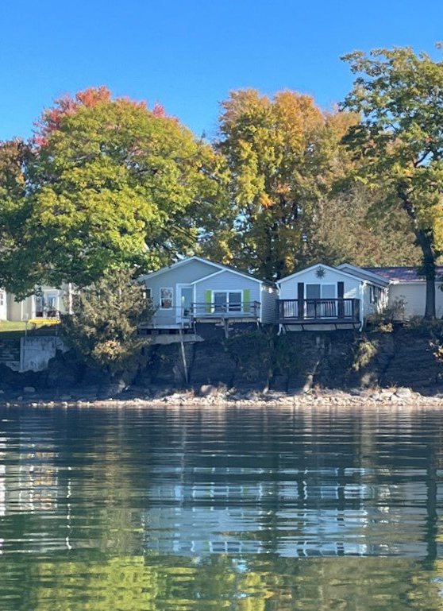
How We Can Serve Your Community
Supporting local partners like Grand Isle County Natural Resource Conservation District​
Direct Lake Basin 5 Water Quality Council​
Project Identification & Development
Lake Wise & Stream Wise consultations​
Connecting community with the watershed
Other technical services as needed
Notes:
FNLC Shoreline Social in 2023 @ Keeler Bay Marina
Lake Wise Assessments 8 completed/3 awards
Keeler Bay LWAP by Grand Isle County Natural Resource Conservation District

Slide 8
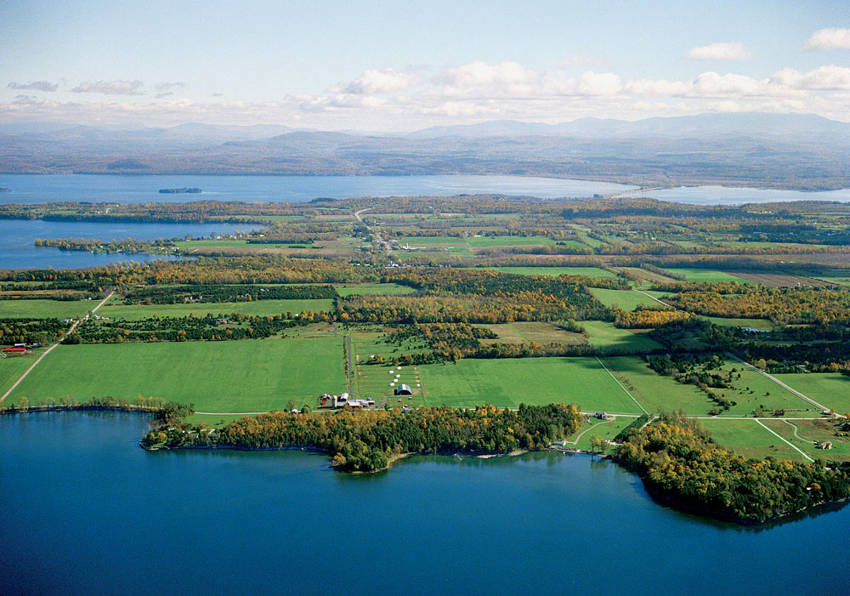
What Are Your Town’s
Needs?

Slide 9
Stay in Touch
www.friendsofnorthernlakechamplain.org
bbutler@friendsofnorthernlakechamplain.org
Notes:
BECOME A BOARD MEMBER
APRIL 14th stream clean up and April 21st Rain Barrel workshop with Mill River Brewing BIKE FOR THE LAKE IS JUNE 15TH EARLY BIRD REG ENDS FRIDAY

