Slide 1
S.H.O.R.E.
South Hero Overland Route Exploration
Funded by a VOREC (Vermont Outdoor Recreation Economic Collaborative) Grant

Slide 2
S.H.O.R.E.
A collaborative project to improve the quality and quantity of bike and pedestrian routes in South Hero

Slide 3
Lake Champlain Islands Manages and implements Fall 2024
Economic Development the S.H.O.R.E. Project
Corporation

Slide 4
GOALS:
Better manage and grow cycling and pedestrian activity
Maximize the economic impact
Promote positive relationships
Enhance routes
Provide safe routes
Increase awareness of businesses

Slide 5
THE PROCESS
Gather information:
Review past studies
Visit and talk to business owners
Conduct informal bike counts
Talk with community members
Survey cyclists

Slide 6
IDENTIFY FINDINGS
Safety
Routes/Signage
Destinations/Amenities

Slide 7
COMMUNITY STAKEHOLDERS
Selectboard
Planning Commission
Recreation Commission
Trails Committee
Folsom Elementary
Businesses
Residents
Tourists
Cyclists

Slide 8
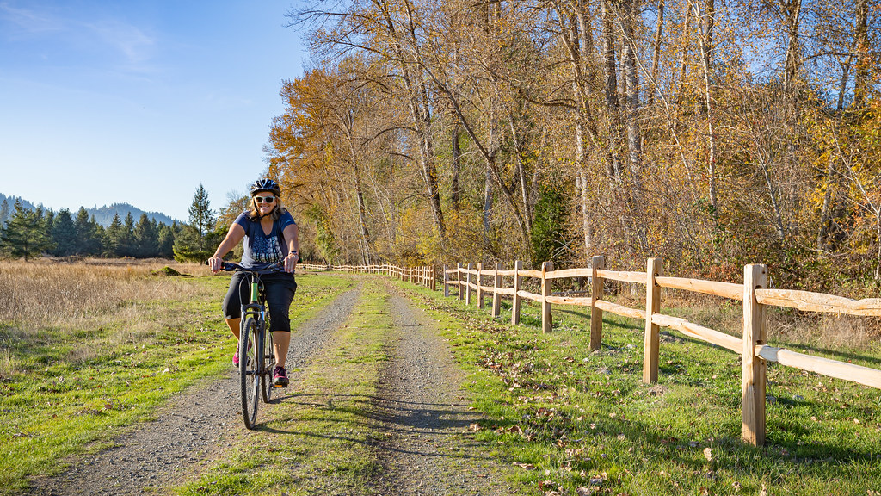
RECREATION PLANNER/CONSULTANT
Funded through VOREC Grant
Works with S.H.O.R.E. Project Coordinator
Design and plan bike/pedestrian improvements
Recommends Demo Projects and Pop-up Events

Slide 9
COMPREHENSIVE PLAN
Town of South Hero Selectboard
Recommendations
What’s Next
Funding opportunities

Slide 10
MARKETING AND CAMPAIGNING
Educational Materials
Educational Events
Maps/Apps
Brochures/literature

Slide 11
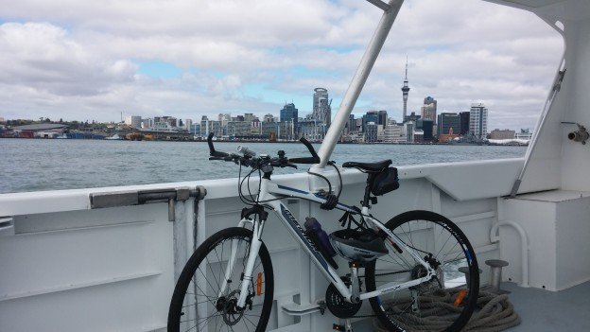
PERMANENT SIGNAGE AND WAYFINDING

Slide 12
HOW TO GET INVOLVED
CONTACT:
Donna Boumil, Project Coordinator
Email: donna@champlainislands.com
802-372-8400
Cyclist survey: www.surveymonkey/r/KRNHYJ6

